Slide 1
Colony group project
04/07/2021

Slide 2
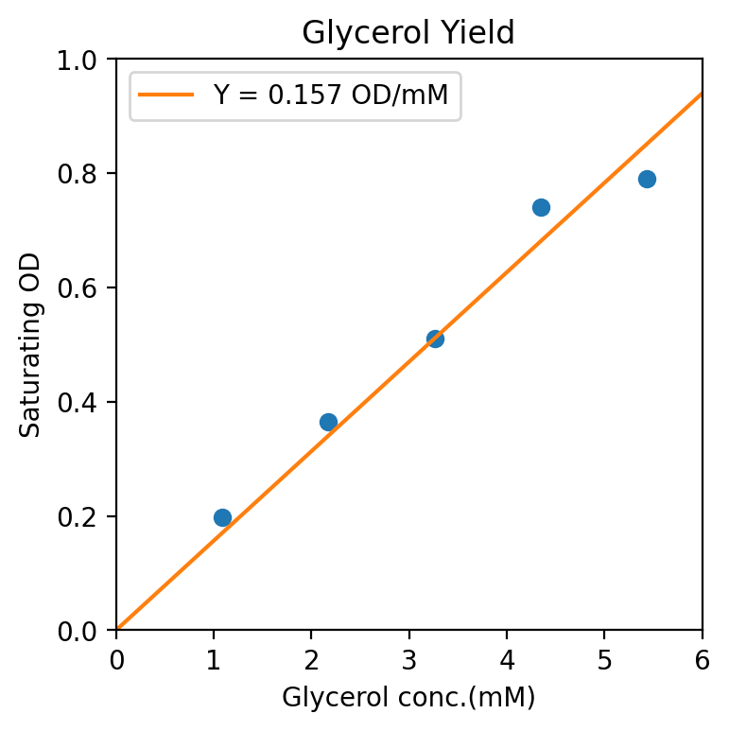
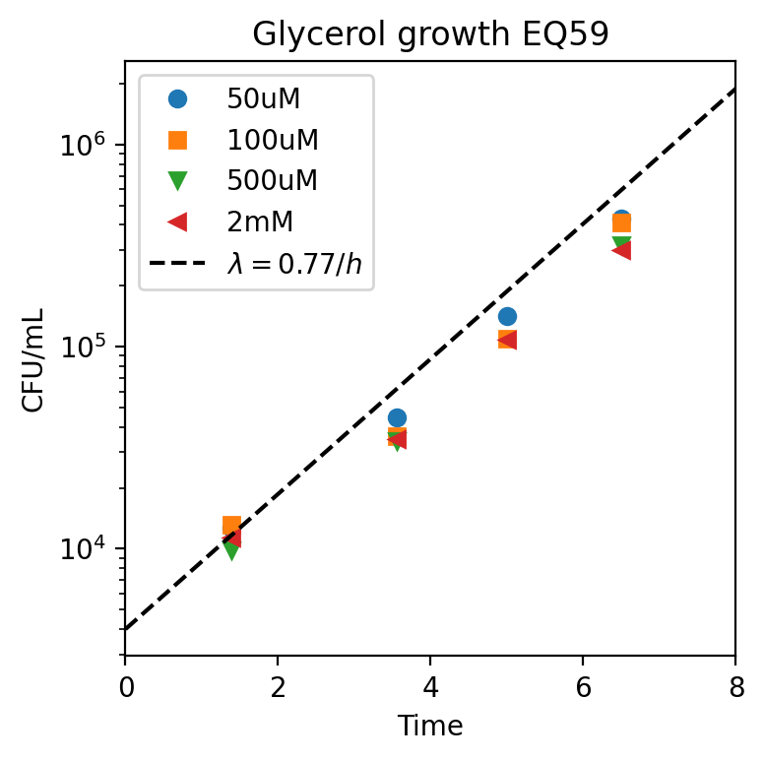
Glycerol Km measurements through CFU
Glycerol

Slide 3
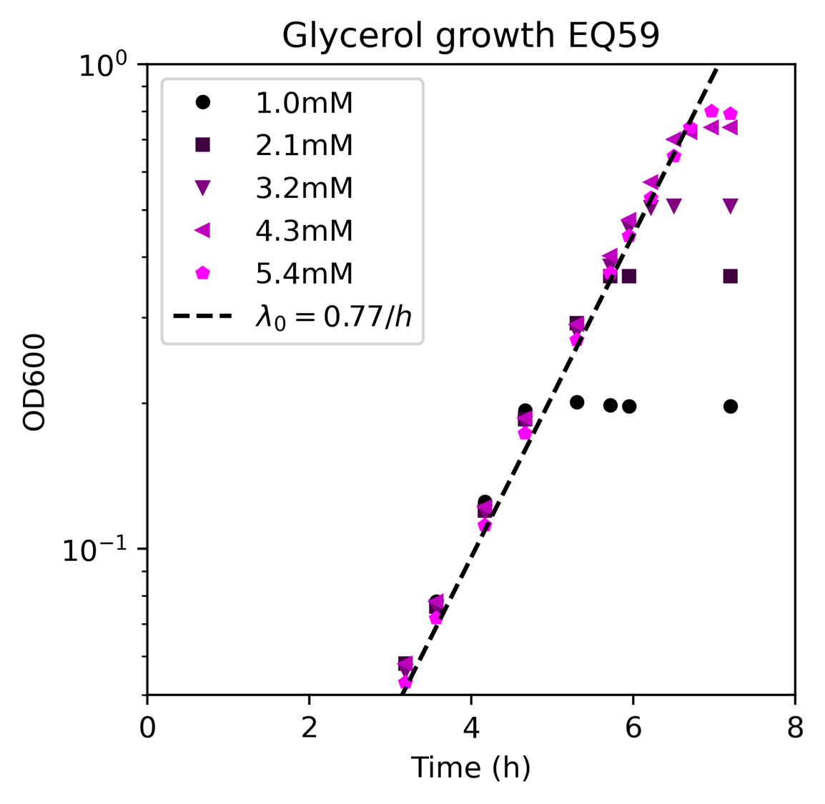
Glycerol Km measurements through OD

Slide 4
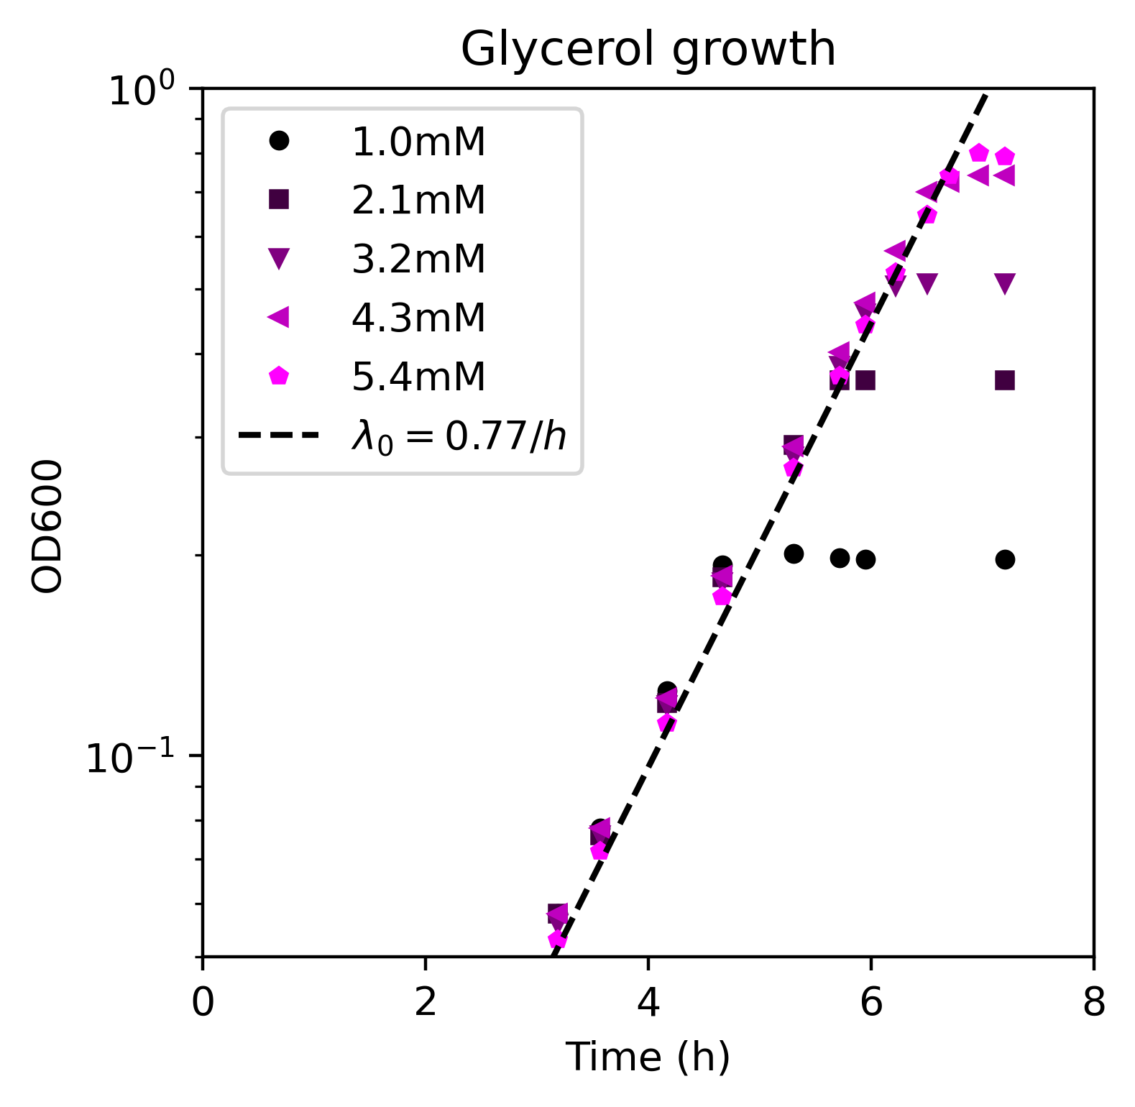
Glycerol Km measurements

Slide 5
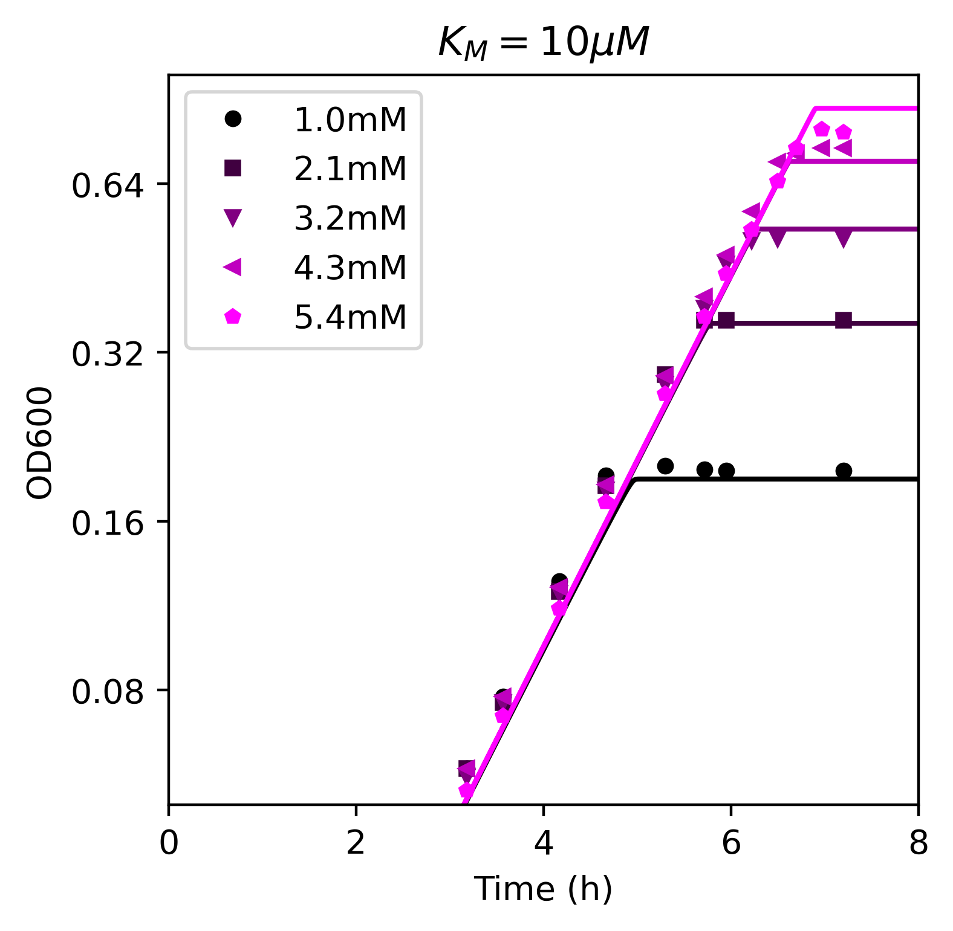
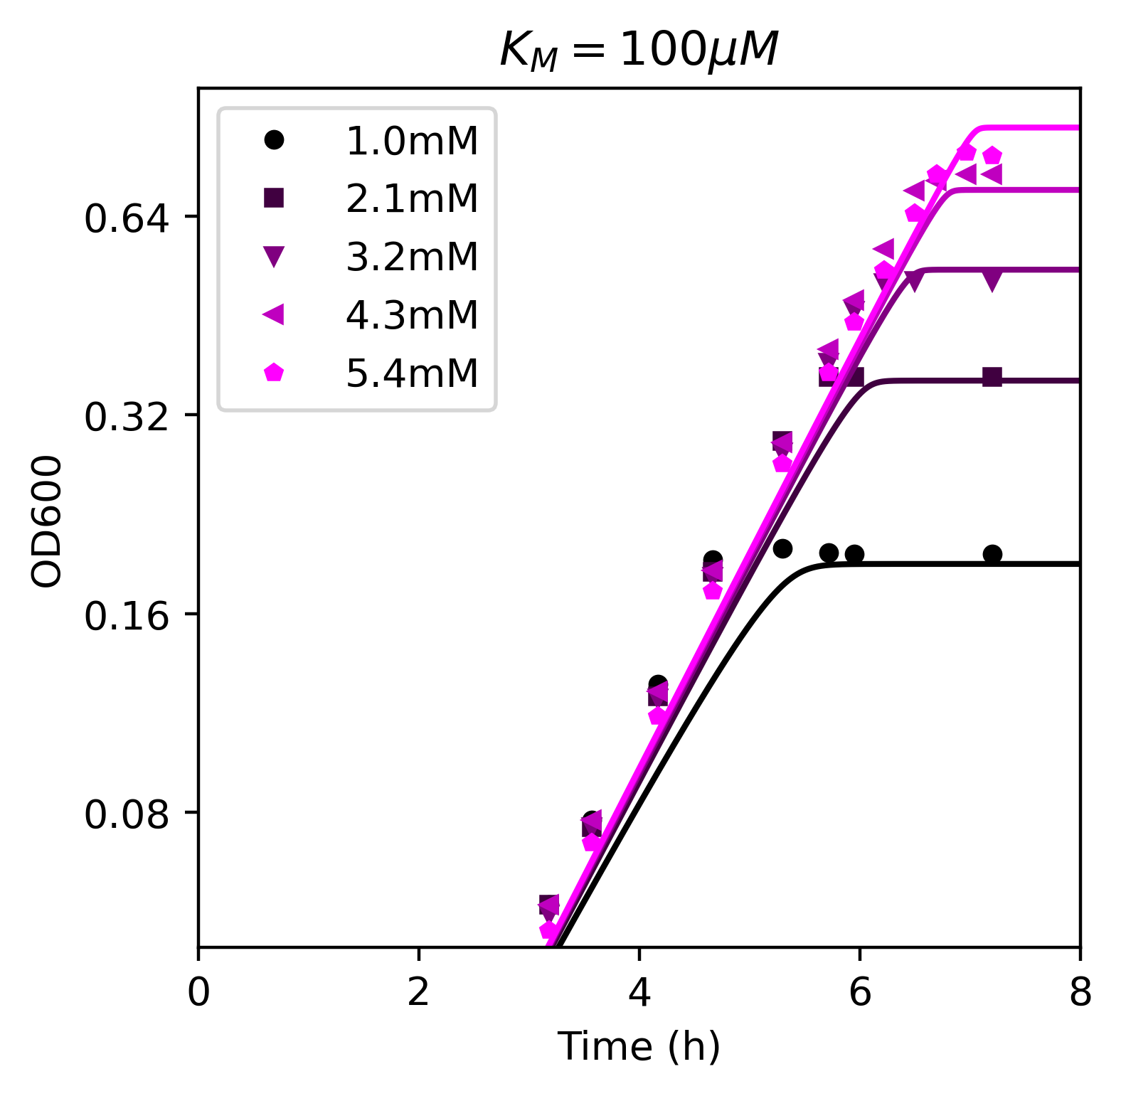
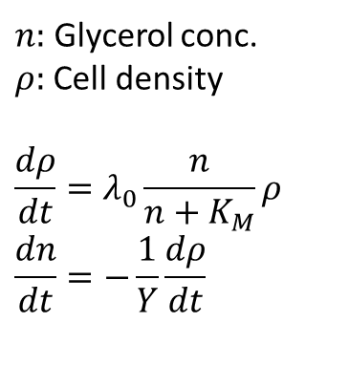

Model fitting for various $K_{M}$
$n:$ Glycerol conc.
$ρ:$Cell density
$$\frac{dρ}{dt}=λ_{0}\frac{n}{n+K_{M}}ρ \\ \frac{dn}{dt}=−\frac{1}{Y}\frac{dρ}{dt}$$

Slide 6
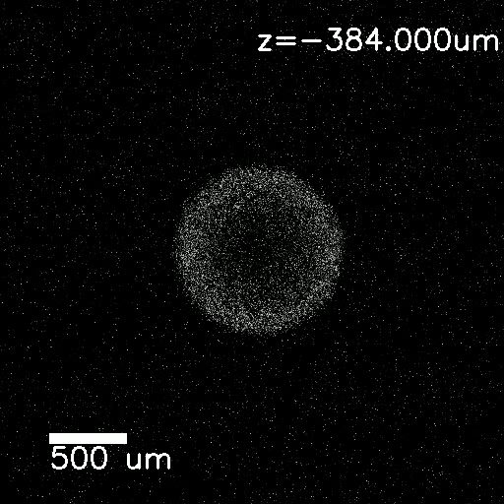
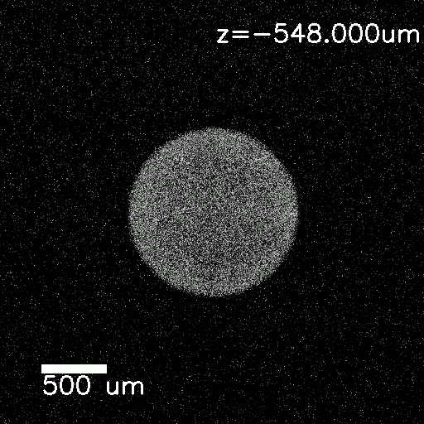
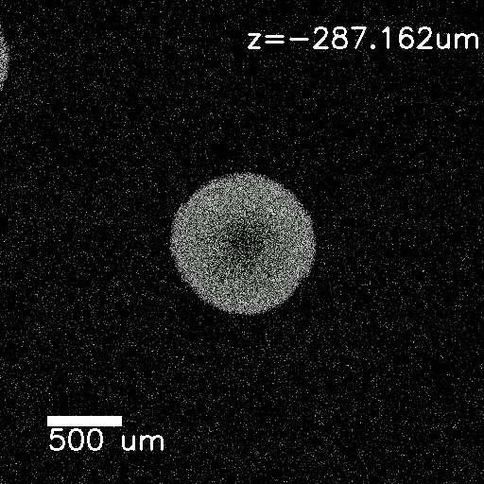
Colony Growth
Glucose
Glycerol
Fructose

Slide 7
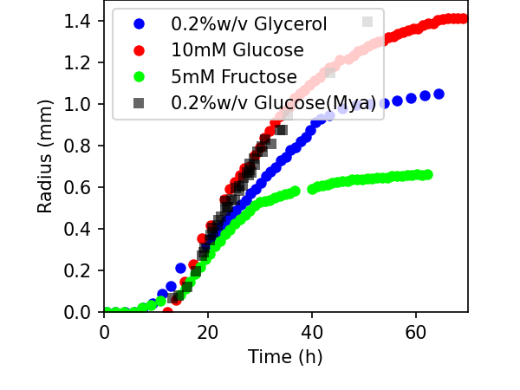
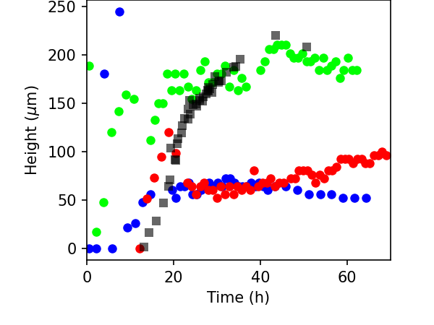
Colony growth

Slide 8
Meeting notes
Reasons for dark inside:
Low oxygen (basis of the model)
Mya put the colony in the fridge, and saw an increase in the GFP for the inside
[x] Check pH of the buffer at lower temperatures (https://www.tandfonline.com/doi/pdf/10.1080/10942910903456978) PBS buffer doesn’t respond to temperature in between 20C-130C
- :A: Miscalculation on my end. The buffer is ~100mM PO4.
Low pH
GFP doesn’t activate for low pH values. Quick test: replace the interior with high buffer to see if there’s an increase.
[ ] Check the interior pH using Brian’s method
- :A: no need to. The expected effect is too low to account for the toxicity.
Measure radial growth of the colony for Fructose
Km measurement:
[ ] Grow EQ59 in glycerol at lower concentrations to measure Km
[ x ] Repeat glucose colony growth for upside down images
[ ] 1A01 Km measurement in GlcNAc

